Slide 1
BODY FAT
Link- C:/Users/91876/Desktop/Kaggle Individual/7_Body fat/Exported files
Data- bodyfat

Slide 2
CHALLENGES IN THE PROJECT
There were many continuous variables with outliers which had to be fixed.

Slide 3
MAJOR FINDING THROUGH EDA
Finding P values and good predictors.

Slide 4
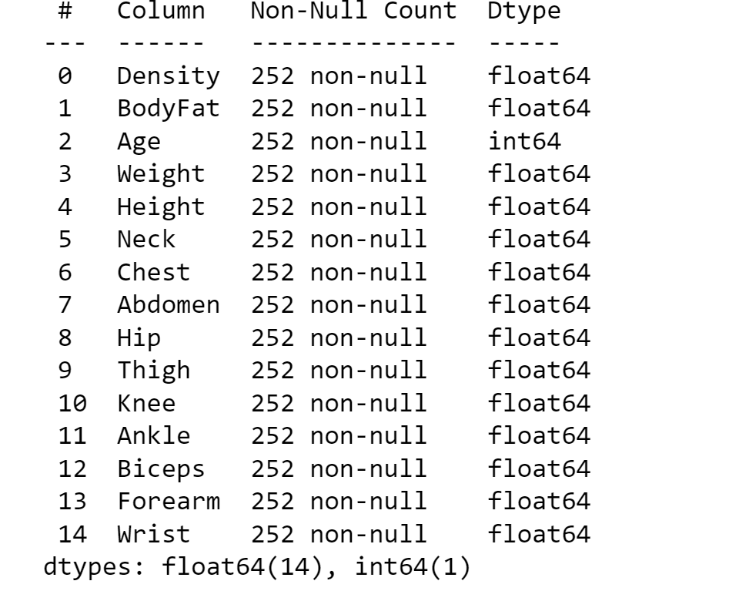
PREDICTION MODEL
Shape-
(252,15)

Slide 5
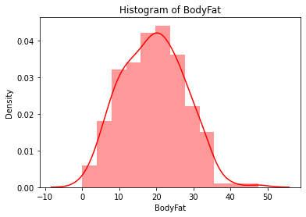
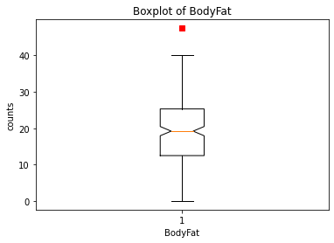
Target Variable- BodyFat
Continuous variable There are outliers
No null values

Slide 6
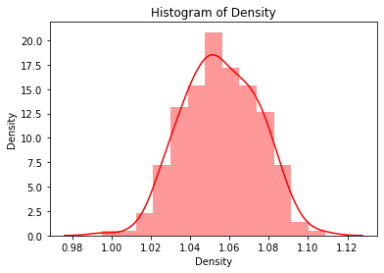
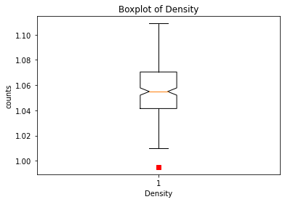
1st variable- Density
Continuous variable There are outliers
No null values Bad predictor

Slide 7
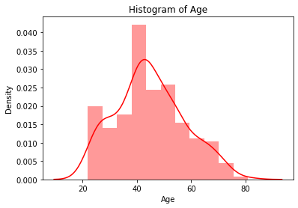
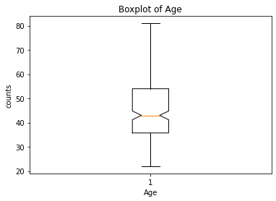
2nd variable- Age
Continuous variable There are no outliers
No null values Good predictor

Slide 8
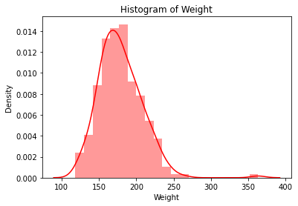
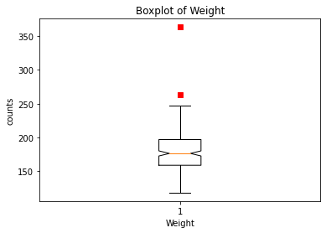
3rd variable- Weight
Continuous variable There are outliers
No null values Bad predictor

Slide 9
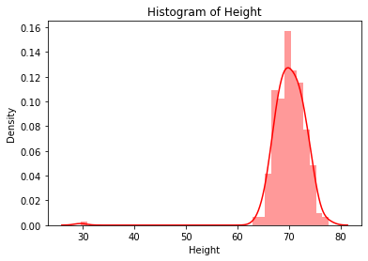
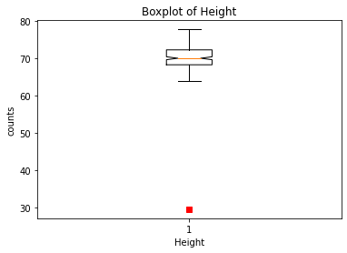
4th variable- Height
Continuous variable There are outliers
No null values Bad predictor

Slide 10

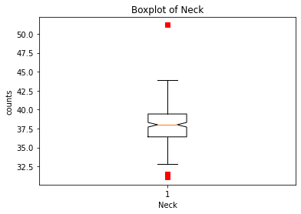
5th variable- Neck
Continuous variable There are outliers
No null values Good predictor

Slide 11
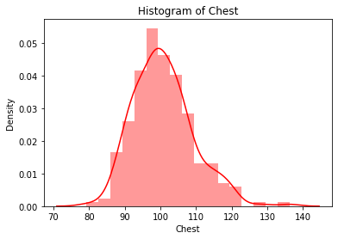

6th variable- Chest
Continuous variable There are outliers
No null values Good predictor

Slide 12
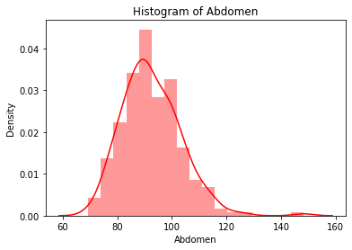
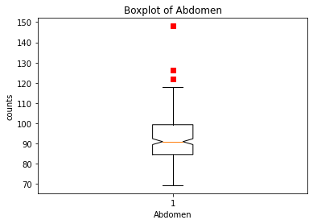
7th variable- Abdomen
Continuous variable There are outliers
No null values Good predictor

Slide 13
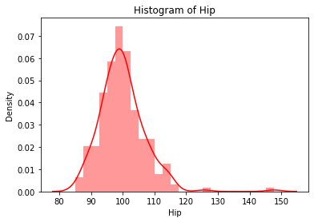
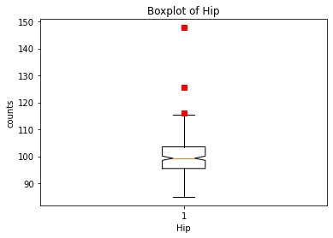
8th variable- Hip
Continuous variable There are outliers
No null values Good predictor

Slide 14
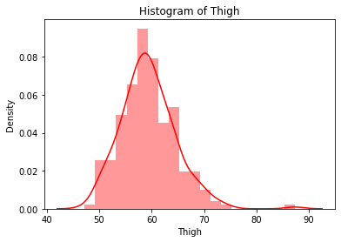
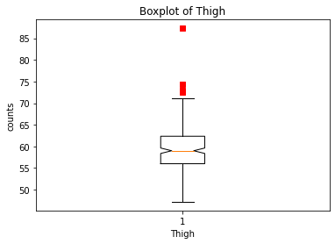
9th variable- Thigh
Continuous variable There are outliers
No null values Good predictor

Slide 15
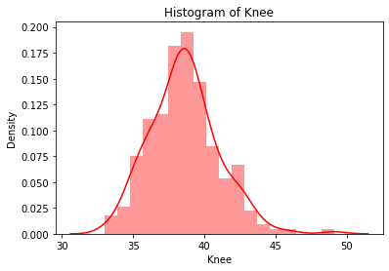
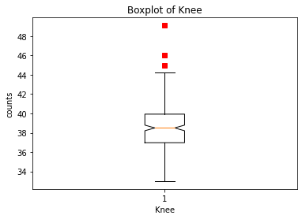
10th variable- Knee
Continuous variable There are outliers
No null values Good predictor

Slide 16
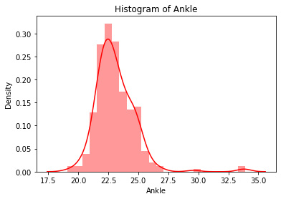
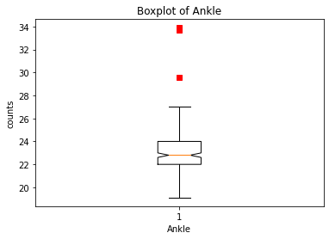
11th variable- Ankle
Continuous variable There are outliers
No null values Good predictor

Slide 17
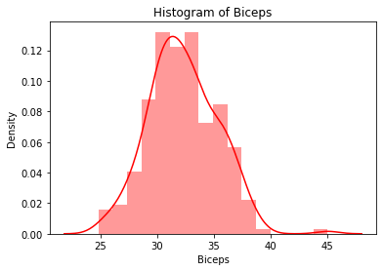
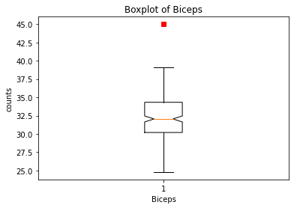
12th variable- Biceps
Continuous variable There are outliers
No null values Good predictor

Slide 18
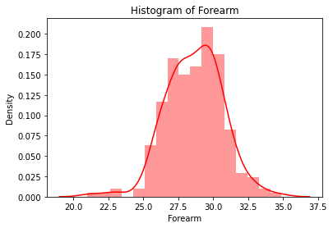
13th variable- Forearm
Continuous variable There are outliers
No null values Good predictor

Slide 19
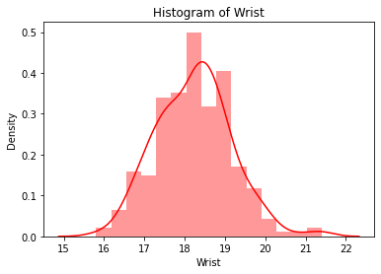
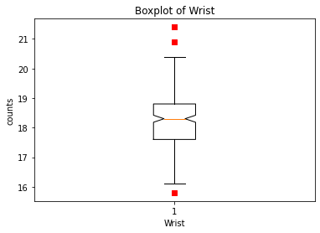
14th variable- Wrist
Continuous variable There are outliers
No null values Good predictor

Slide 20
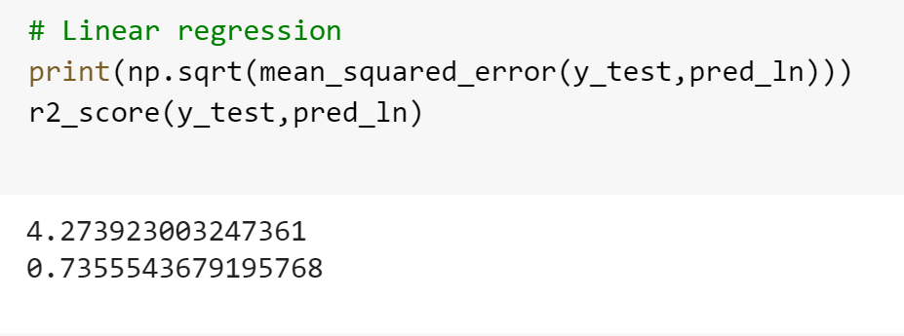
LINEAR REGRESSION MODEL

Slide 21
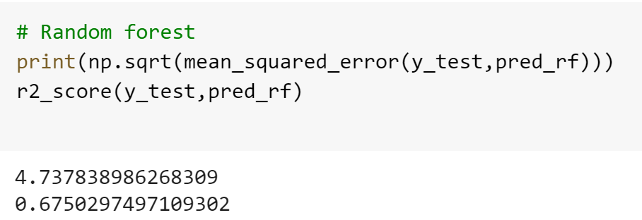
RANDOM FOREST MODEL

Slide 22
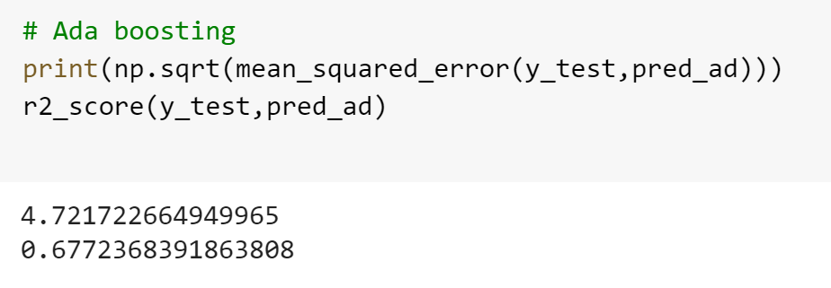
ADA BOOSTING MODEL

Slide 23
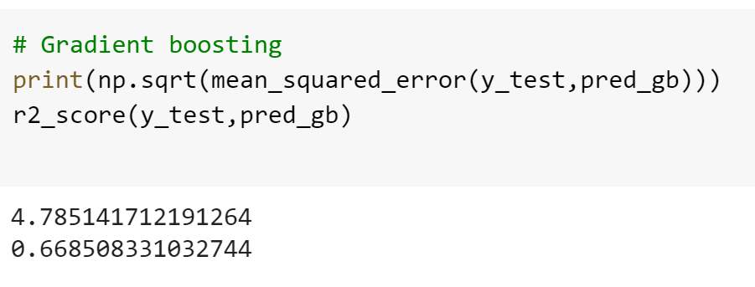
GRADIENT BOOSTING MODEL

Slide 24
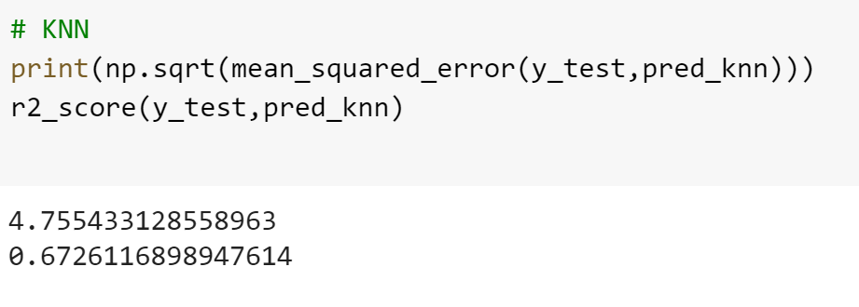
KNOW YOUR NEAREST NEIGHBOURS(KNN) MODEL

Slide 25
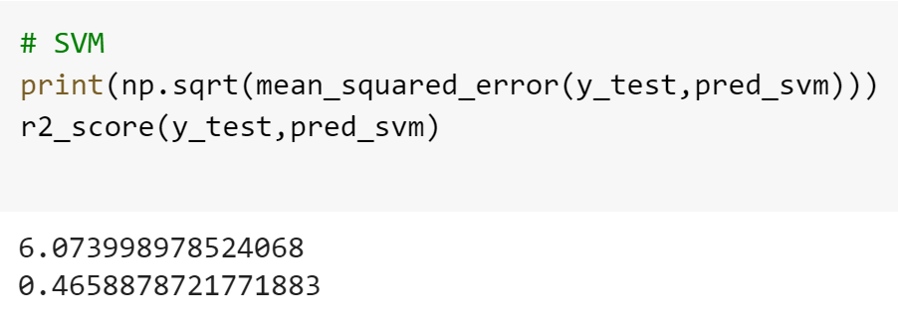
SUPPORT VECTOR MACHINE(SVM) MODEL

Slide 26
Best model to be considered is Linear regression model which has accuracy of 0.73.

Slide 27
THANK YOU

